Slide 1

ANTI-MONEY LAUNDERING (AML) detection system
Team Members:
Rohit Eerabattini Shashank raj gupta Gunta Yeshwanth

Slide 2
PROJECT OVERVIEW AND PROBLEM STATEMENT
Project Overview: Our project focuses on the development of an Anti Money Laundering (AML) Detection System, which aims to identify and flag suspicious financial transactions indicative of money laundering activities.
Problem Statement: Money laundering poses a significant threat to the integrity of financial systems worldwide. Detecting and preventing illicit financial activities is crucial for maintaining regulatory compliance and ensuring the security of financial institutions.

Slide 3
TECHNOLOGIES IMPLEMENTED
Apache Spark: Utilized for scalable and distributed processing of large volumes of transaction data.
PySpark: Python API for Apache Spark, enabling seamless integration of Spark with Python-based data analysis and machine learning libraries.
Pandas, NumPy, Matplotlib, Seaborn: Employed for data exploration, visualization, and analysis.
Scikit-learn: Used for implementing machine learning models such as Logistic Regression and Random Forest Classifier.

Slide 4
Understanding IBM's Synthetic Financial Data for AML
Purpose of Data:
Synthetic data was created to model financial transactions for training anti-money laundering (AML) models.
Helps overcome the challenges of accessing real financial data due to privacy and proprietary restrictions.
Data Description
Data simulates an entire financial ecosystem involving individuals, companies, and banks.
Includes all forms of financial transactions like purchases, payments, loans, etc.
Special focus on criminal activities like smuggling and illegal gambling, tracking money through multiple transactions to identify laundering.
Benefits of Synthetic Data
Complete visibility of financial transactions across multiple institutions.
It is more comprehensive than real-world data, which is typically limited to transactions within one institution.

Slide 5
Datasets Overview and Practical Application
Dataset Variants
Six datasets split into two groups: High Illicit (HI) and Low Illicit (LI) ratios.
Each group has three sizes: Small, Medium, Large, to support various computational resources.
Dataset Statistics (Example: LI Medium): Date Range: Sep 1-16, 2022
Total Bank Accounts: 2,028K
Total Transactions: 31M
Laundering Transactions: 16K
Laundering Rate: 1 per 1,948 transactions
Usage
We have employed the dataset "5a. LI-Medium_Trans.csv Transactions" for model training.
The recommended data split for effective modeling is 60% Train, 20% Validate, and 20% Test.

Slide 6
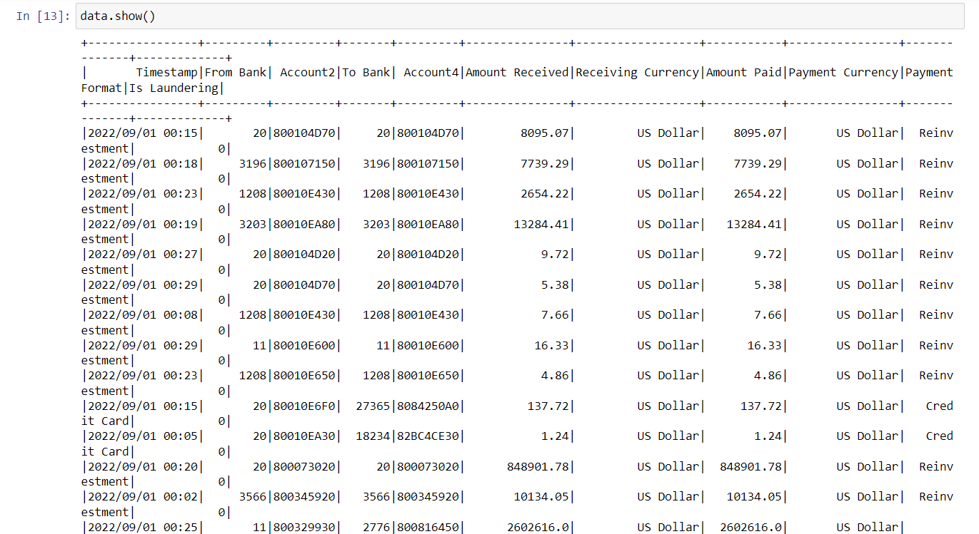

Slide 7
DATA PREPROCESSING AND EXPLORATION
Data Preprocessing: Steps involved cleaning and preparing the dataset for analysis, including handling missing values and renaming columns.
Exploratory Data Analysis (EDA): Conducted to gain insights into the distribution of data, identify patterns, and understand the relationships between variables.
Visualizations: Histograms depicting distributions of transaction amounts, payment format distribution, correlation matrix heatmap, etc.

Slide 8
FEATURE ENGINEERING AND MODEL TRAINING
Feature Engineering: Categorical variables were transformed using StringIndexer and OneHotEncoder, and numerical features were assembled into a feature vector.
Model Training: Logistic Regression and Random Forest Classifier were trained using the processed data. The dataset was split into training and testing sets for model evaluation.
Model Evaluation: The performance of the models was evaluated using metrics such as Area Under ROC curve (AUC) to assess their predictive accuracy.

Slide 9
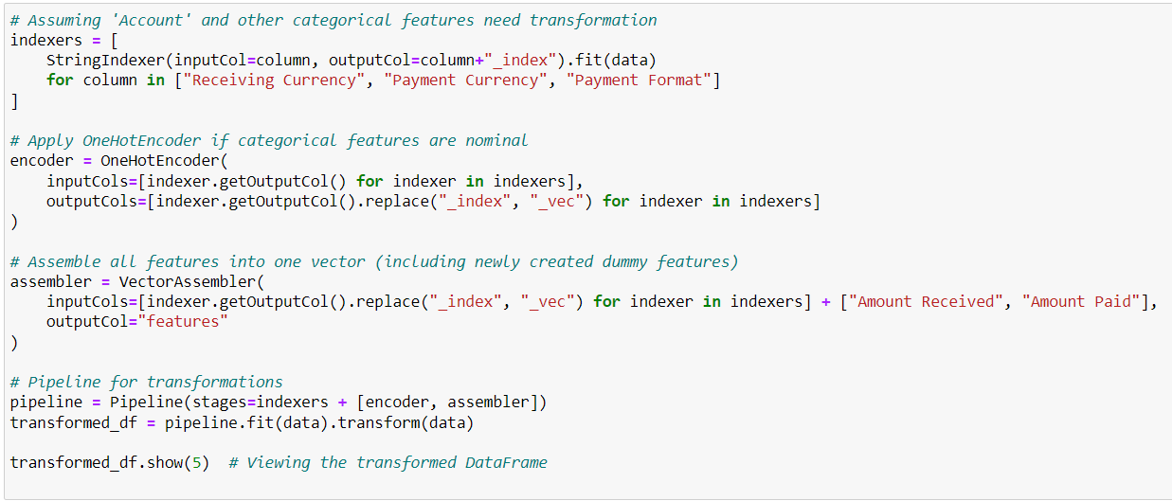
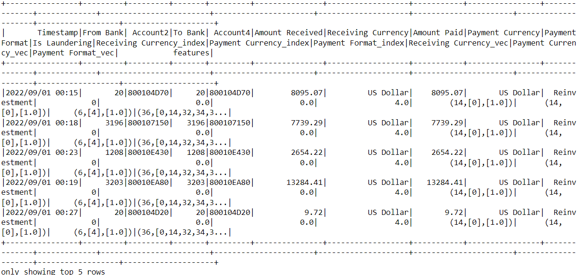
Feature engineering
Output:

Slide 10
ALTERNATIVE APPROACH WITH PIPELINE
Pipeline Approach: An alternative approach was explored using Pipeline, which streamlined the feature engineering and model training process.
Pipeline Components: Categorical variable transformation, feature assembly, scaling, and model training were encapsulated within a single pipeline.
Comparison: Results obtained from the Pipeline approach were compared with the previous method to assess improvements in model performance and efficiency.

Slide 11
RESULTS AND DISCUSSION
Summary of Results: Presented AUC scores and model accuracy metrics for both Logistic Regression and Random Forest Classifier.
Discussion: Engaged in a discussion on the effectiveness of the models in identifying money laundering transactions, highlighting strengths and limitations.
Challenges and Future Work: Addressed challenges encountered during model development and proposed avenues for future research and improvement.

Slide 12
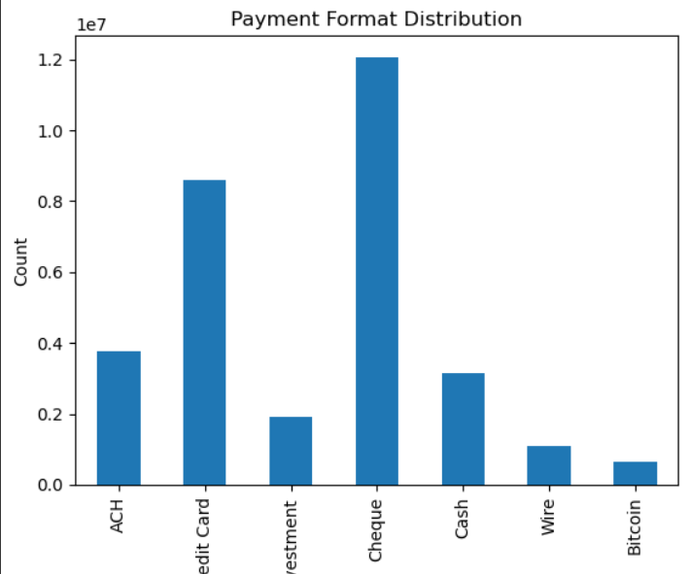
Payment Format distribution
Cash is the most common form of payment in the United States, according to this graph. It accounts for a higher percentage of transactions than any other payment type.
Credit cards are the second most popular payment method, followed by debit cards. ACH payments, wire transfers, investments, and checks make up a smaller portion of payment methods used in the U.S.

Slide 13
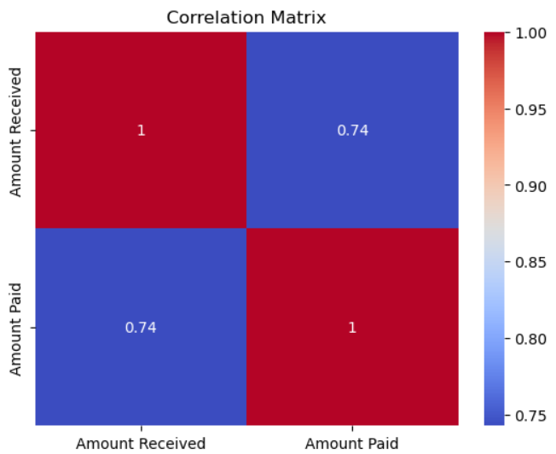
Correlation Matrix
This correlation matrix shows the relationship between the amount of money received and the amount of money paid.
The closer the value in a cell is to 1, the stronger the positive correlation between the two variables. In this case, the amount received has a very strong positive correlation with the amount paid (0.95). This means that when the amount received increases, the amount paid also increases.

Slide 14
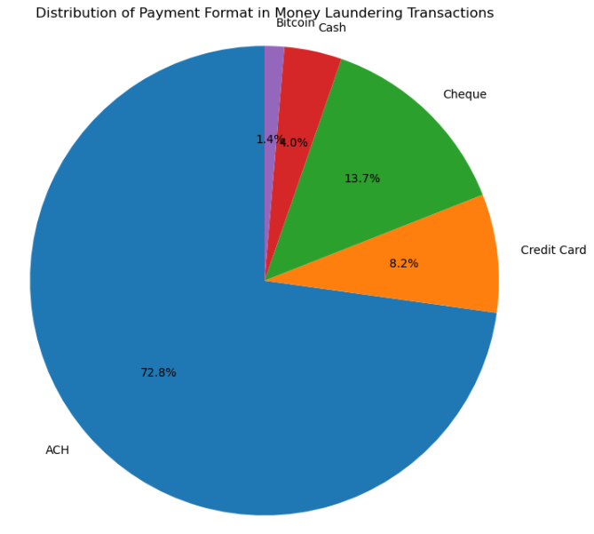
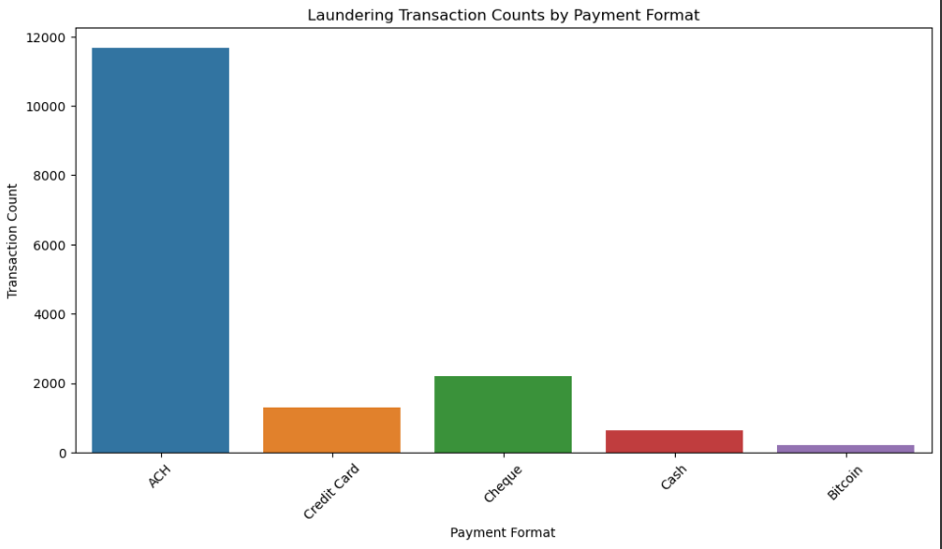
Payment Formats in Laundering Transactions

Slide 15
FURTHER ANALYSIS
Potential Extensions: Explored potential avenues for further analysis, including fine-tuning model parameters, incorporating additional features, or exploring advanced machine learning techniques.
Ensemble Methods: Considered the application of ensemble methods or deep learning approaches for enhanced predictive performance.

Slide 16
CONCLUSION
Summary: Summarized key findings and insights gained from the project, emphasizing the successful implementation of a predictive model for AML detection.
Lessons Learned: Reflected on lessons learned from working on the project, including the importance of data preprocessing and feature engineering in model development.
Future Directions: Discussed future directions for research or projects in the field of financial security and anti-money laundering.

